Slide 1
Natural Resources

Slide 2
Content
Renewable and non-renewable resources :
Natural resources and associated problems.
a) Forest resources : Use and over-exploitation, deforestation, case studies. Timber extraction, mining, dams and their effects on forest and tribal people.
b) Water resources : Use and over-utilization of surface and ground water, floods, drought, conflicts over water, dams-benefits and problems.
c) Mineral resources : Use and exploitation, environmental effects of extracting and using mineral resources, case studies.
d) Food resources : World food problems, changes caused by agriculture and overgrazing, effects of modern agriculture, fertilizer-pesticide problems, water logging, salinity, case studies.
e) Energy resources : Growing energy needs, renewable and non renewable energy sources, use of alternate energy sources. Case studies.
f) Land resources : Land as a resource, land degradation, man induced landslides, soil erosion and desertification.
• Role of an individual in conservation of natural resources.
• Equitable use of resoureces for sustainable lifestyles

Slide 3
Problem of sustainability with Natural Resources
Natural Resources
Sustainable use
Unsustainable use
Rural systems
Urban systems

Slide 4
Earth’s spheres
Atmosphere (Air)
Biosphere
Hydrosphere (Water)
Lithosphere (Land)

Slide 5
Natural Resources and Associated Problems
Two major problems:
Unequal consumption of natural resources
per capita consumption, Ecological Footprint (EF)
2. Planning land use
rational land policy, atleast 10% must be wilderness

Slide 6
Indicators of sustainable lifestyles
In Humans (Human Development Index):
1. Increased longevity
2. An increase in knowledge
3. An enhancement of income
In Ecosystems:
1. A stabilized population or the percentage of species loss
2. Species diversity in ecosystems
3. State of ‘naturalness’ of ecosystems

Slide 7



Natural Resources
Forest
Water
Mineral
Food
Energy
Land
Renewable
Non Renewable
Note: Energy has both renewable and non-renewable sources. All other natural resources are renewable in nature.

Slide 8
Forest Resources
People who live in or near forests only know the value of forest resources first-hand.
Reserved and Protected Forests established by British before independence has led to alienation of local people (in conservation).
Consequently, after Independence of India, there was loss of stake in conservation and led to rapid degradation and fragmentation along the length and breadth of the country. State sponspored agricultural expansion became the highest priority.

Slide 9
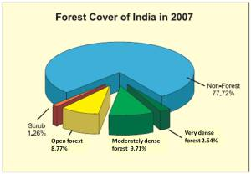
Forests have a pivotal role in a nation’s economy.
(Source: https://greencleanguide.com/forest-inventory/)

Slide 10
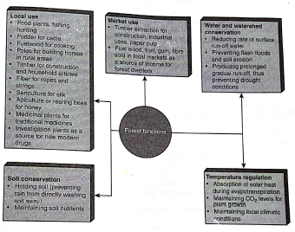
Importance of Forest Resource

Slide 11
Threats on Forest resources
Deforestation and degradaton:
Expansion of agricultural land
Rapid industrialisation
Urbanisation
Illegal logging
Mining

Slide 12
Initiative of JFM to conserve forest resources
Joint Forest Management is involving the participation of local communities as stake holders in conservation of forest resources.
MoEF through National Forest Policy of 1988 gave enhanced importance to JFM.
In 1990, the concept of Village Forest Committies (VFC) in joint management was established.
In 2000, it was made mandatory that atleast 25% of the forest income must be utilized for the community.
VFCs in Telangana and Andhra Pradesh receive entire 100% income.
NTFPs (Non-timber Forest Products), rotational grazing etc are implemented.

Slide 13
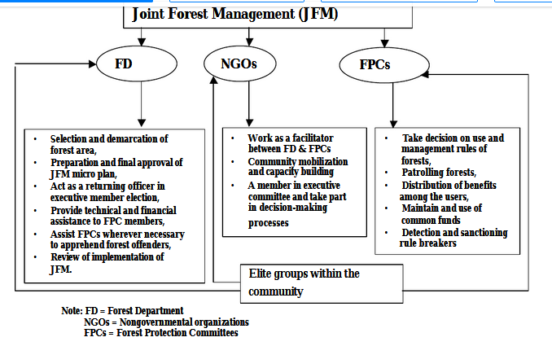
(Source:https://www.researchgate.net/publication/253576584_Determinants_of_Sustainable_Management_of_Natural_Resources_The_Case_of_Joint_Forest_Management_JFM_in_India)

Slide 14
Water Resources
Water covers 70% of the earth’s surface but only 3% of this is fresh water.
Of this small proportion of fresh water, globally 70% is used for agriculture, 22% for industry and 8% for domestic purposes. However, India uses 87% for agriculture, 8% for industry and 5% for domestic use. (National Commission for Water Resources Development Plan, Ministry of Water Resources, 1999).
Toughest challenge in the world is efficient management of water resources.

Slide 15
Local water conflicts in states of India
There are 100 countries that share the waters of 13 large rivers and lakes. The upstream countries could starve the downstream nations, leading to political instability across the world. Ex: Ethiopia (upstream) and Egypt (downstream) depend on river Nile. International accords for fair distribution are critical to world peace.
Toughest challenge in the world is efficient management of water resources.

Slide 16
Threats to Water resources
Mismanagement and pollution
Global climate change (Floods and Drought)
Problems caused by large dams
There are more than 45,000 large dams around the
world. (India and China contribute 57%)
Hydropower contributes 19% of the world’s total electric
power supply and is used in over 150 countries.

Slide 17
Environmental Problems caused by large dams
Fragmentation and physical transformation of rivers
Serious impact on riverine ecosystems
Social consequences of large dams due to displacement of people
Water logging and salinisation of the surrounding lands
Dislodging animal populations, damaging their habitat and cutting off their migratory routes
Disruption of fishing and waterway traffic
The emission of green house gases from reservoirs due to rotting vegetation and carbon inflows from the catchment

Slide 18
Measures for better management of world’s water resources
Building several small reservoirs
Developing small catchment dams and protecting wetlands
Soil management, micro-catchment development and afforestation
Treating and recycling municipal waste water for agricultural use
Preventing leakages from dams and canals
Preventing loss in municipal pipes
Effective rain water harvesting and recharging of ground water in urban environments

Slide 19
Pricing water at its real value, which makes people use it more responsibly and efficiently and reduces wastage
In deforested areas where land has been degraded, soil management by making bunds along the hill slopes and making nalla plugs, can help retain moisture and make it possible to revegetate degraded areas.

Slide 20
Mineral Resources
A mineral is a naturally occuring substance of definite chemical composition and identfiable physical properties.
Minerals are formed over a period of millions of years in the earth’s crust. They can be broadly classified into metallic and non-metallic resources.
Mining is the process of extracting minerals and their ores from the earth’s interior.

Slide 21
Mining operations consists of four stages:
Prospecting: Searching for minerals
Exploration: Qualitative assessment
Development: Work of preparing access to the deposit.
Exploitation: extracting the minerals
Mining is of two types: surface (open-cast or strip
mines) and underground (deep or shaft mines).

Slide 22
Threats due to Mining
Mining Hazards to workers:
Surface mining is less hazardous than underground mining.
Metal mining is less hazardous than coal mining.
Accidents:
Use of explosives in metal mines
Rock and roof falls, flooding and inadequate ventilation in underground mines
Health risks: dust causes ‘black lung’ or pneumoconiosis.
Poisonous fumes are generated by incomplete dynamite explosions.
Methane gas from coal strata and radiation from radioactive mines.

Slide 23
Threats due to Mining
Environmental problems:
Depletion of available land
Waste from mining industries
Conversion of land to industry
Pollution of air, water and land

Slide 24
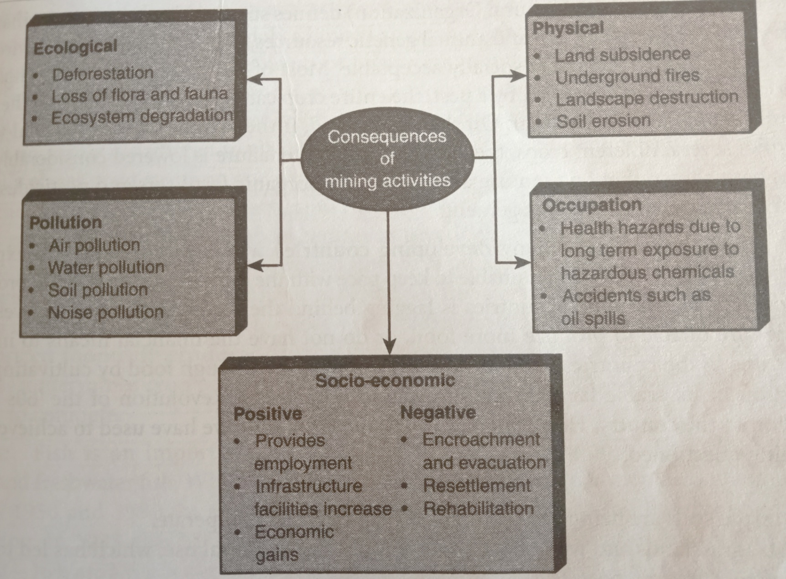
Consequences of mining activities

Slide 25
Food Resources
Global food demand is met from three major sources: agriculture, animal husbandry and fisheries.
Modern practises of food production has led to yield increase but has resulted in environmental damage and loss of food quality (unsustainable).
FAO has defined sustainable agriculture as that which conserves land, water, plant and animal resources, does not degrade the environment and is economically viable and socially acceptable.

Slide 26
The major impediment in food supply is scarcity (need of food security) and unsustainable practises of food production and exploitation.
World food problems: Food production in 64 of the 105 developing countries is lagging behind their population growth levels. India has produced enough by Green revolution of the 60’s but there are serious environmental impacts and issues of sustainability.
Globally, 5-7 million ha of farmland is degraded each year.

Slide 27
Problems in Agriculture
Monoculture or single crop harvesting
Chemical fertilizers and pesticides use increases the salinity of soil and declines the fertility in due course.
Demand for meat based food increases the demand for feed of livestock based on agriculture. It also results in more land per unit of food produced.
Forests, grasslands and wetlands pt to agriculture use leads to ecological dangers.

Slide 28
Food security
Earth can only supply a limited amount of food.
Food security is closely linked with population control through family welfare program.
Food security is only possible if food is equitably distributed to all.
Major concerns are the lack of support to small farmers and dumping of underpriced food stuff produced in the developed world onto markets in underdeveloped countries.

Slide 29
Fisheries
Fish is an important source of protein.
While fish supply increased from 1950 to 1990 but the fish catch has dropped due to overfishing.
In 1995, FAO reported that 44% of the world’s fisheries are fully or heavily exploited.
Modern fishing technology using mechanised trawlers and small meshed nets have led to overfishing.

Slide 30
Loss of genetic diversity
There are only 50,000 known edible plants documented worldwide. Of these, only 15 varieties produce 90% of the world food.
Modern agriculture practises have resulted in serious loss of genetic variability of crops.
India has 50,000 varieties of rice
Growing single or few varieties of a crop may create a risk of food security due to rapid spread of a disease (genetic variability may provide resistance to the disease).

Slide 31
Alternative food sources
Multiple non wood forest products can be used as food (such as fruits, mushrooms, sap, gum etc).
Medicines can be harvested sustainably from forests. (Taxol for cancer, Cinchona bark for malaria etc).
Using unfamiliar crops such as Nagli (highly nutritive), which are grown on poor soil on hill slopes.
Unused sea food products like sea weed.

Slide 32
Sustainable food production
Integrated crop management
Growing multiple crops in a year, adopting soil conservation measures, enhancing the soil with organic matter, rotating crops and managing watersheds at the micro-level.
Integrated pest management
Preserving pest predators, using pest resistant seed varieties and reducing the use of chemical fertilizers.

Slide 33
Energy Resources
Energy is found in a variety of forms, some of which are immediately useful, while others require a process of transformation.
Sun is the primary source of energy.
No energy related technology is completely ‘risk free’.
Energy has always been linked to man’s economic growth and development.

Slide 34
For almost 200 years, coal was the primary energy source, fuelling the Industrial Revolution in the 19th century.
Globally, 39% of oil, 24% of coal, 24% of natural gas, 7% of nuclear energy and 6% of hydro/other renewal sources are utilized for energy consumption. In India, 55% of energy demand is met from coal, followed by oil (31%), natural gas (8%), hydro (5%) and nuclear power (1%) as per an estimate in 2001.
There are three types of energy: non-renewable, renewable and nuclear energy.
Electricity is the fastest growing form of end-use energy worldwide. A large proportion of energy from electricity is wasted during transmission as well as at the user level.

Slide 35
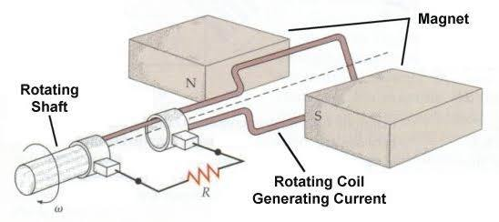
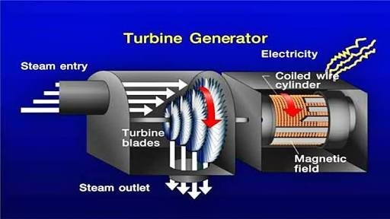
Non-renewable energy
To produce electricity from non-renewable resources, the material must first be ignited. The fuel is placed in a secured area and set on fire. The heat thus generated turns water to steam, which moves through pipes, to turn the blades of a turbine. This converts magnetism into electricity.

Slide 36
Non-renewable energy sources: are mineral based hydrocarbon fuels (coal, oil and natural gas – fossil fuels).
At the present rate of extraction, coal may be available for more than a century. But, oil and natural gas will exhaust completely within 50 years. As we cannot regenerate them immediately, we have to find alternative energy sources to meet our growing needs.
Fossil fuel consumption is bad for the environment – causes air pollution (respiratory problems and damage to historic monuments, forests & lakes), green house effect leading to global warming and its consequences.
Due to the above mentioned reasons, we are exploring clean energy sources which can be replenished to meet our growing energy needs sustainably.

Slide 37
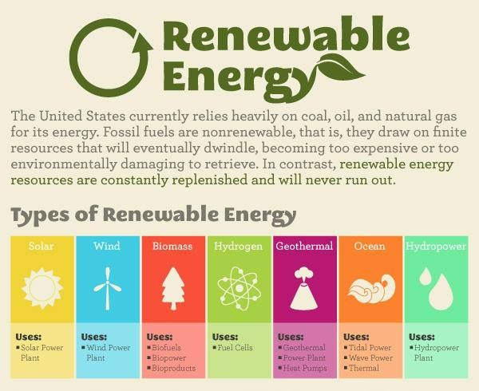
“Source: https://healthresearchfunding.org/pros-cons-renewable-resources/”

Slide 38
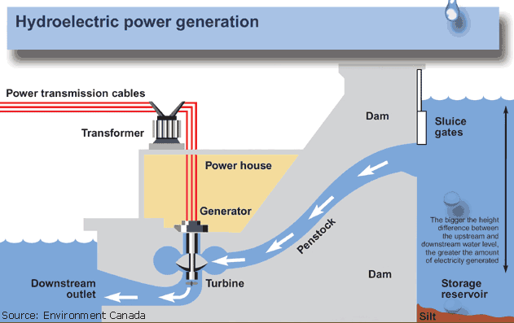
“Source: https://www.solarreviews.com/blog/hydroelectric-energy-pros-and-cons”

Slide 39
Advantages of Hydroelectric power
Long life
Renewable
Very low operating and maintenance costs
Absence of inflationary pressure

Slide 40
Drawbacks of Hydroelectric power
Large areas of forest and agricultural lands are submerged
Silting of the reservoirs
Conflicts over equitable allocation of water
The use of rivers for navigation and fisheries becomes difficult
Resettlement of displaced people
In certain seismically sensitive regions, large dams can induce increased seismic activity resulting in earthquakes. Ex: Tehri dam

Slide 41
Solution
Develop small hydroelectric generation units instead of large dams
China has the largest number of such small units (60,000) generating 30% of China’s electricity.
When are where was the world’s first hydroelectric power dam constructed ?
In India, who built the first hydroelectric power dam?

Slide 42
Solar energy
Just one hour of sunlight has the potential to supply an yearly consumption of global energy needs (we need the technology to harness it).
Solar Power
Heating
Electricity
Heating
Buildings
Heating
water
Solar
cookers
Other solar
powered devices
Solar thermal
Electric power
(STE)
Solar
Panels (PV)

Slide 43
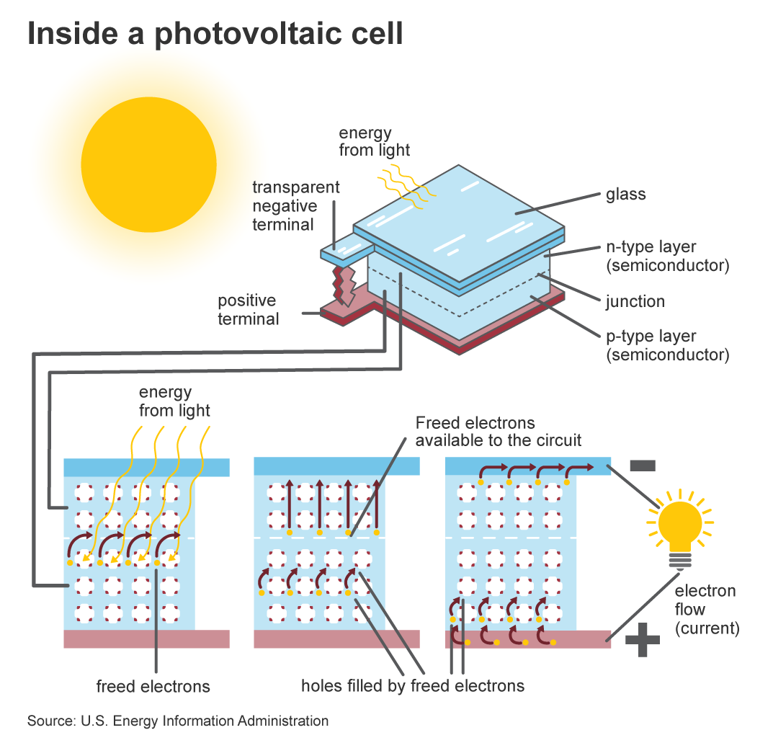
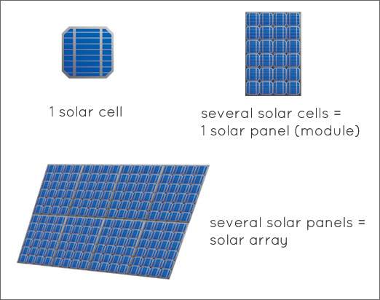

Slide 44
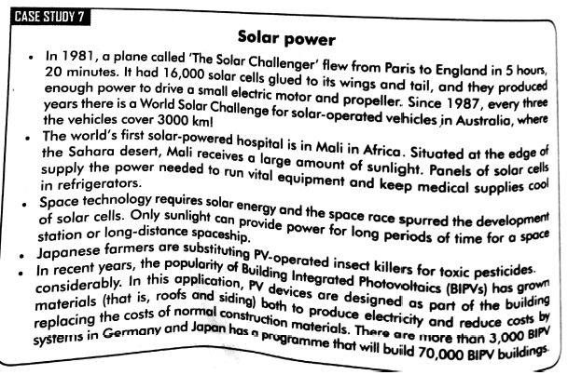

Slide 45
Biomass energy
Biomass energy is a form of stored solar energy (burn to produce heat and electricity).
Biomass energy
Solid
Liquid
Gas
Municipal solid
waste
Biofuels (ethanol,
methanol, biodiesel)
Biogas (mixture of
methane, CO₂, H₂S
and water vapour)
** CH₄ burns

Slide 46
Wind energy
Ancient use of wind energy – sailing ships, drawing water for irrigation and grind grain.
Early work for generating electricity from wind was carried out in Denmark. Today, Denmark and California have large wind turbine cooperatives which sell electricity to the government grid.
______ is the third largest producer of wind energy in the world.
Tamil Nadu has large wind farms (850 mW of electricity).

Slide 47
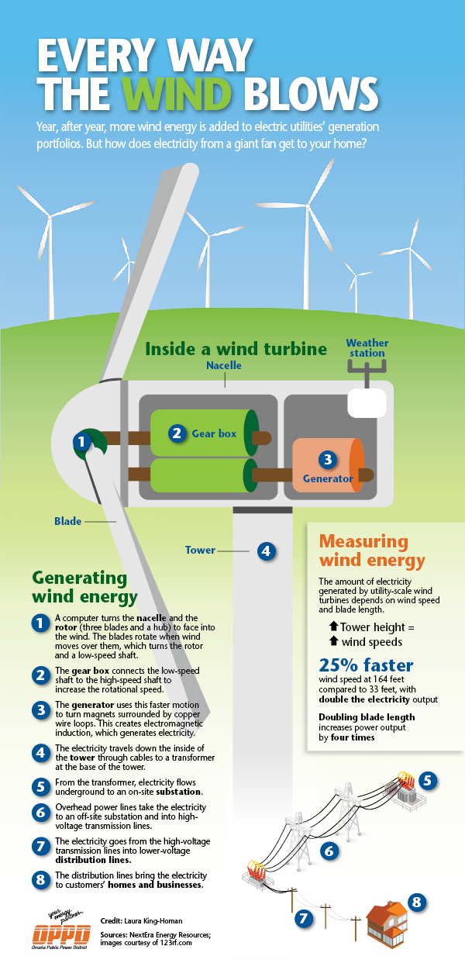
Are all areas suitable to harness wind energy?
(Hint: Wind speed increases with height)
Advantages:
No air or water emissions, radiation or solid waste production.
Drawbacks:
Bird kills, noise, effect on TV reception and aesthetic objections. (Wind is an intermittent source)

Slide 48
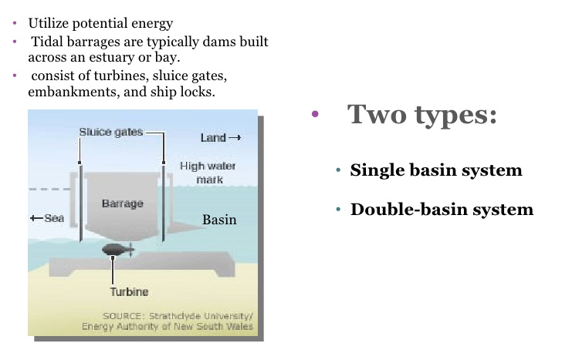
Tidal and Wave power
Harness the kinetic energy of the ocean to generate electricity.
Tidal power is tapped by placing a barrage across an estuary and forcing the tidal flow to pass through turbines.
Tidal barrages are low walled dams. Turbines located at the bottom of the barrage are turned with the incoming and outgoing tides.

Slide 49
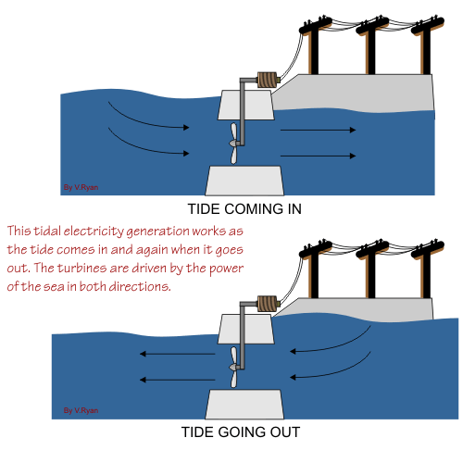
Tidal power tapping affects coastal ecosystems, destroy the habitats and nesting places of water birds and interfere with fisheries; blocks the flow of polluted water into sea (causing health and pollution hazards), navigational hazards, residual drift current affects spawning of some fish, affect migratory patterns of surface swimming fish.
(Source: https://www.alternative-energy-news.info/technology/hydro/tidal-power/)

Slide 50
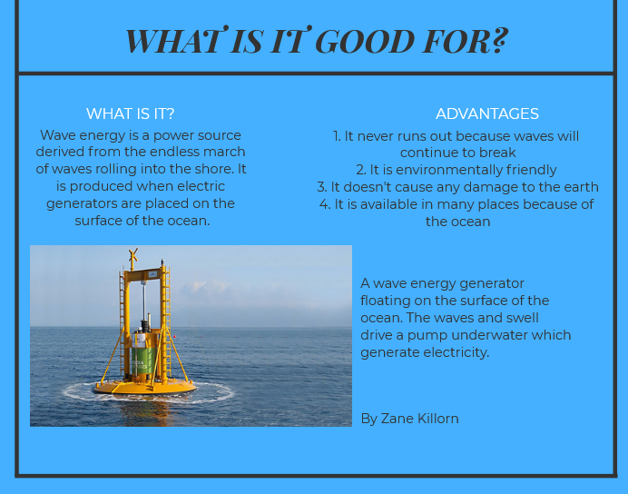
Wave power converts the motion of waves into electrical or mechanical energy. Electricity generated at sea is transmitted by cable to land.
(Source: https://venngage.net/p/80641/wave-energy)

Slide 51
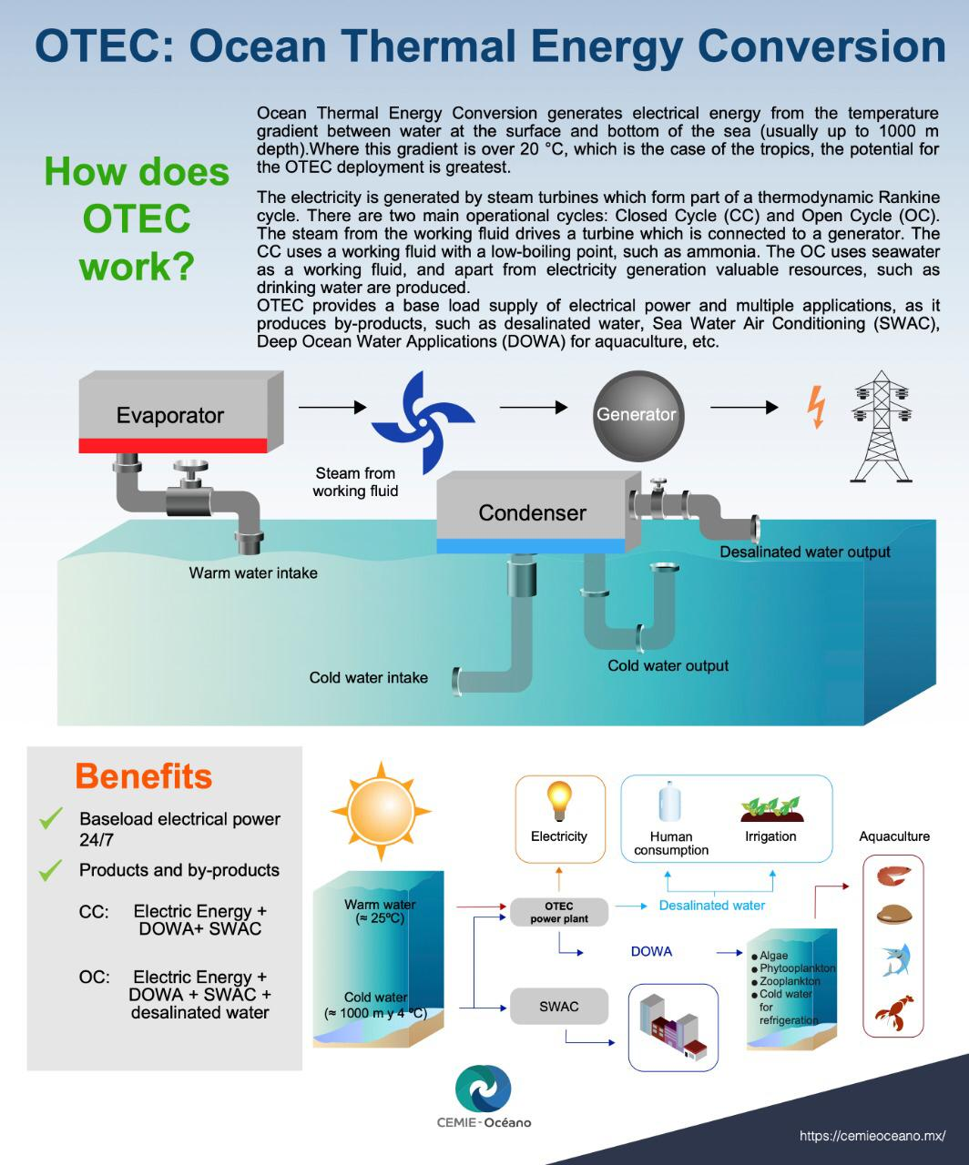
Ocean Thermal Energy Conversion (OTEC) is a high tech installation to harness the energy due to differences in temperature between the warm upper layers and the cold deep layers of the sea or ocean.
India has one OTEC plant in Tiruchendur, Tamil Nadu.

Slide 52
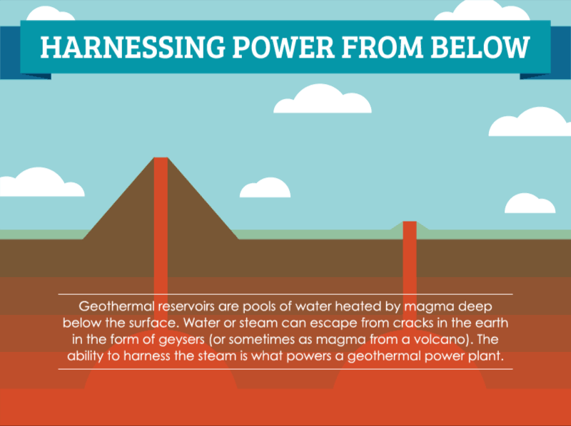
Geothermal energy
(Source: https://www.saveonenergy.com/how-geothermal-energy-works/)

Slide 53
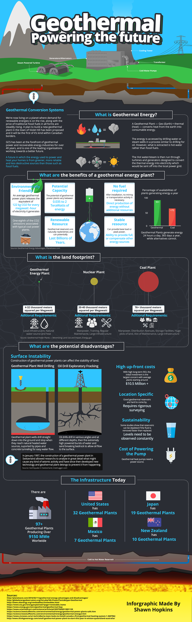

Slide 54
Geothermal energy is harnessed on a large scale for space heating, industrial use and electricity production, especially in Iceland, Japan and New Zealand.
Water from geothermal reservoirs often contain minerals that are corrosive and polluting.
(Source: https://www.behance.net/gallery/72726353/Stylized-Infographic-Geothermal-Energy)

Slide 55
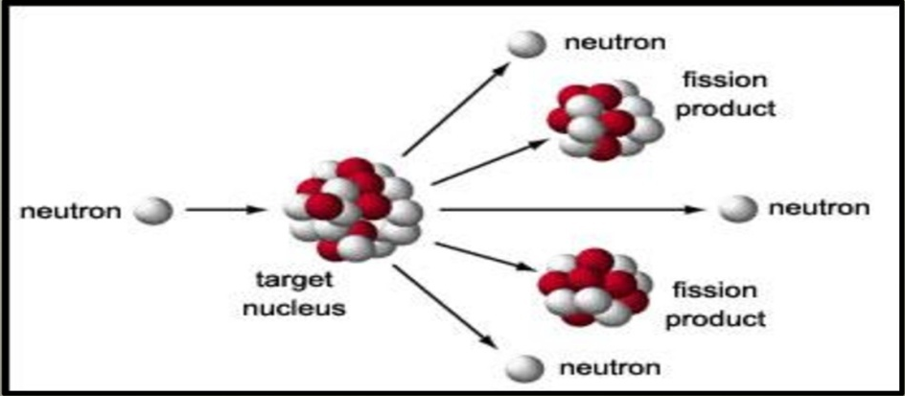
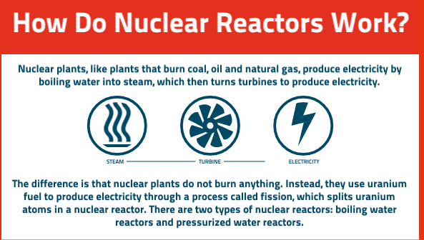
Nuclear energy (Limitless energy)
E=mc²
Nuclei mass is transformed
into energy
(Source: https://www.bechtel.com/bechtel/media/html/how-nuclear-reactors-work.html)

Slide 56
Facts to be known
The first nuclear power plant in the world is in Pennsylvania, USA.
Homi Bhabha is the father of nuclear power development in India ….. BARC
India has uranium mines in Bihar and thorium deposits in Kerala and Tamil Nadu.
The energy from 1 Kg of U-235 is equivalent to that produced by burning 3,000 tonnes of coal.
Chain reaction is initiated by neutron bombardment and controlled by control rods which absorb neutrons in the nuclear reactor.

Slide 57
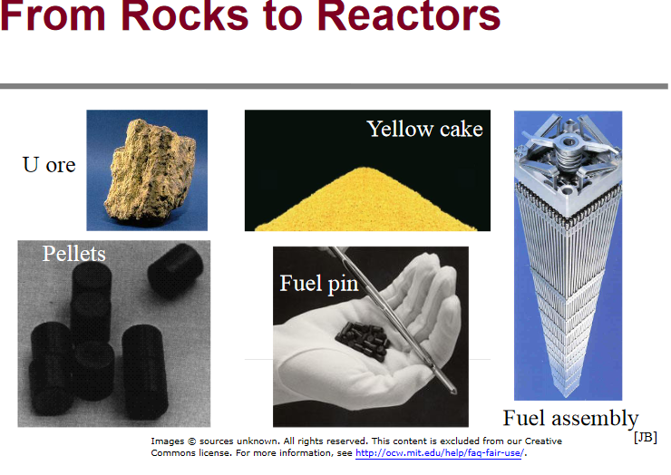

Slide 58
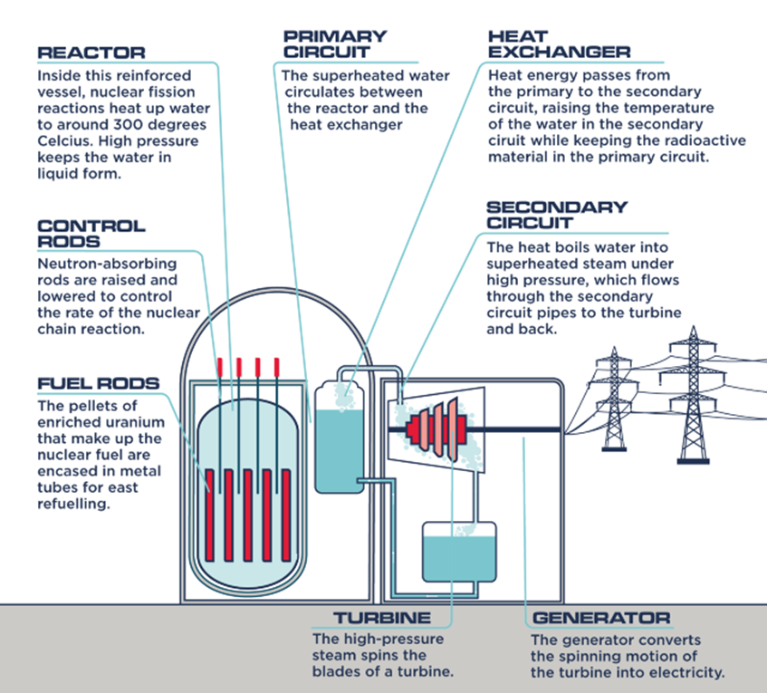
(Source: https://ourfuture.energy/how-it-works/nuclear-power-station/)

Slide 59
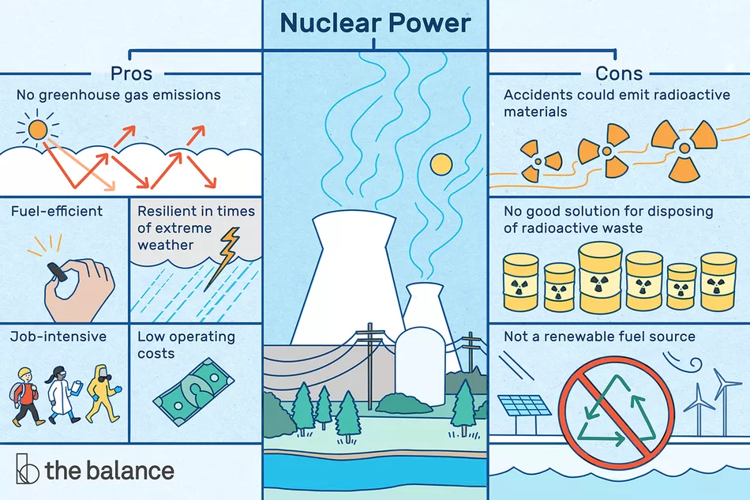
(Source: https://www.thebalance.com/nuclear-power-how-it-works-pros-cons-impact-3306336)

Slide 60
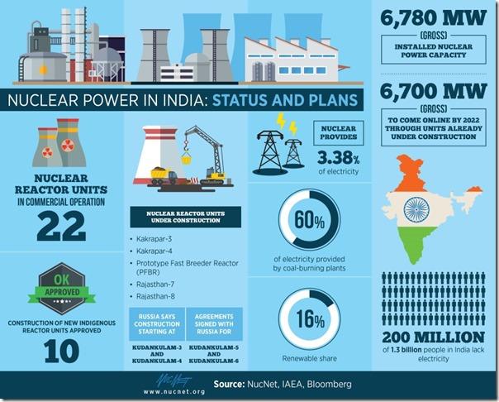
(Source: https://neutronbytes.com/2018/04/06/india-slashes-plans-for-new-nuclear-reactors-by-two-thirds/)

Slide 61
Energy conservation
Shift to alternative and renewable energy sources
Minimizing electricity losses during transmission and distribution (~30-45% even before it reaches consumer)
Deploying small hydrogenation dams
Enhancing fuelwood plantations
Using energy efficient cooking stoves or chulhas
Solar powered irrigation pumps ………………………………………

Slide 62
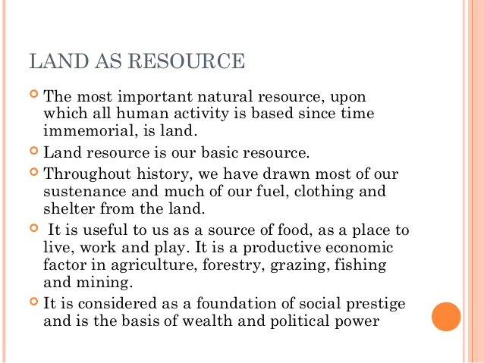
(Source: https://www.slideshare.net/Boicha/land-resources-53702040)

Slide 63
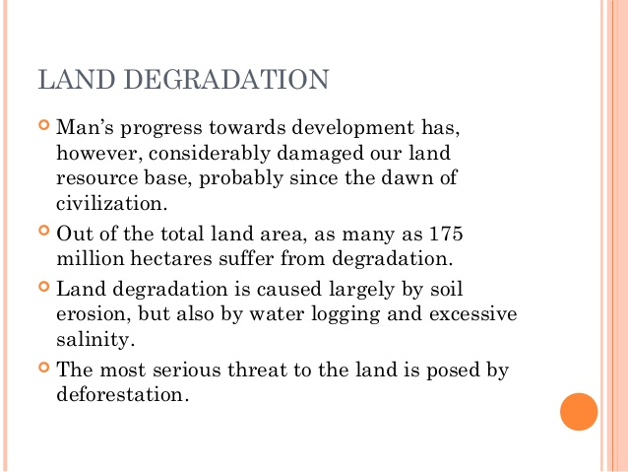
(Source: https://www.slideshare.net/Boicha/land-resources-53702040)

Slide 64
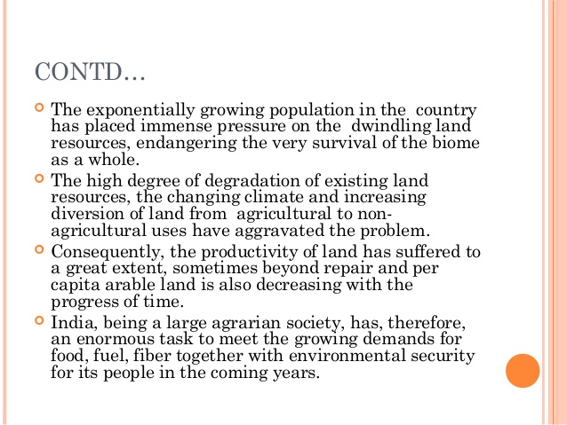
(Source: https://www.slideshare.net/Boicha/land-resources-53702040)

Slide 65
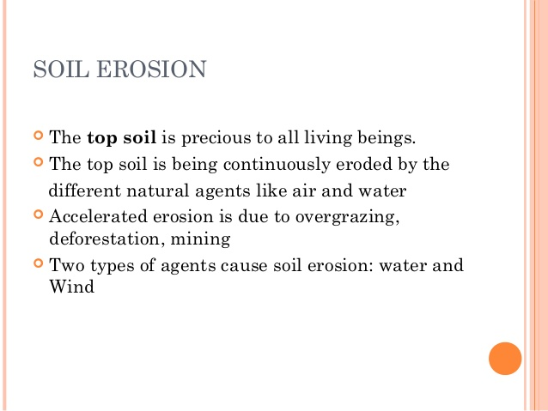
(Source: https://www.slideshare.net/Boicha/land-resources-53702040)

Slide 66
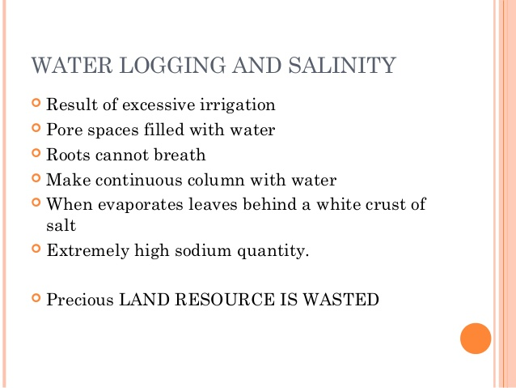
(Source: https://www.slideshare.net/Boicha/land-resources-53702040)

Slide 67
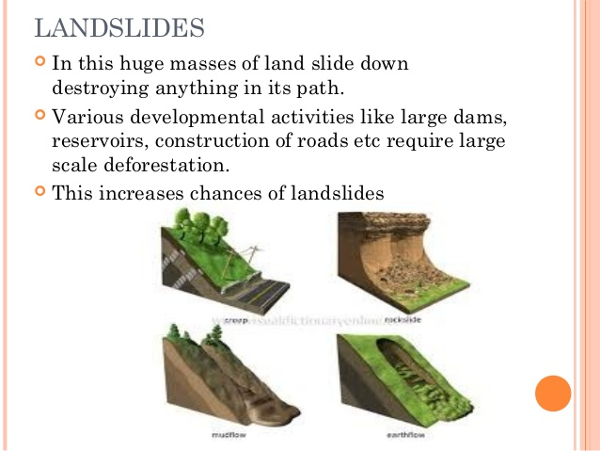
(Source: https://www.slideshare.net/Boicha/land-resources-53702040)

Slide 68
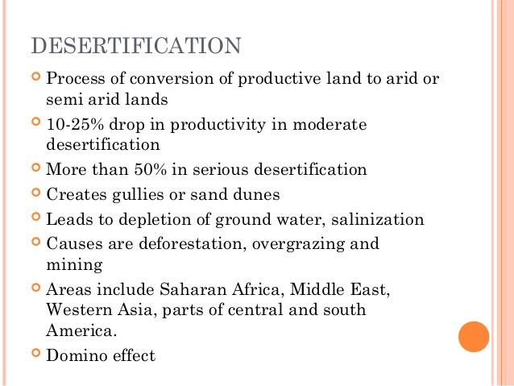
(Source: https://www.slideshare.net/Boicha/land-resources-53702040)

Slide 69
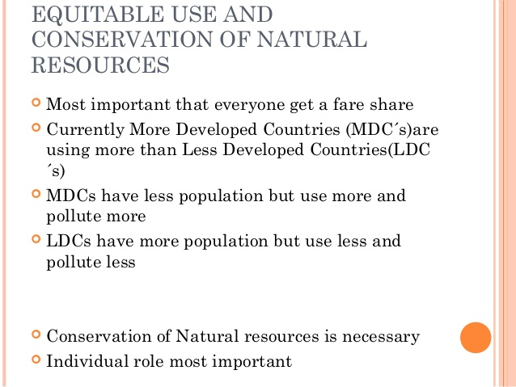
(Source: https://www.slideshare.net/Boicha/land-resources-53702040)

Slide 70
Thank You

